Slide 1
Force Function
Siemens
© 2021 John Sefcovic

Slide 2
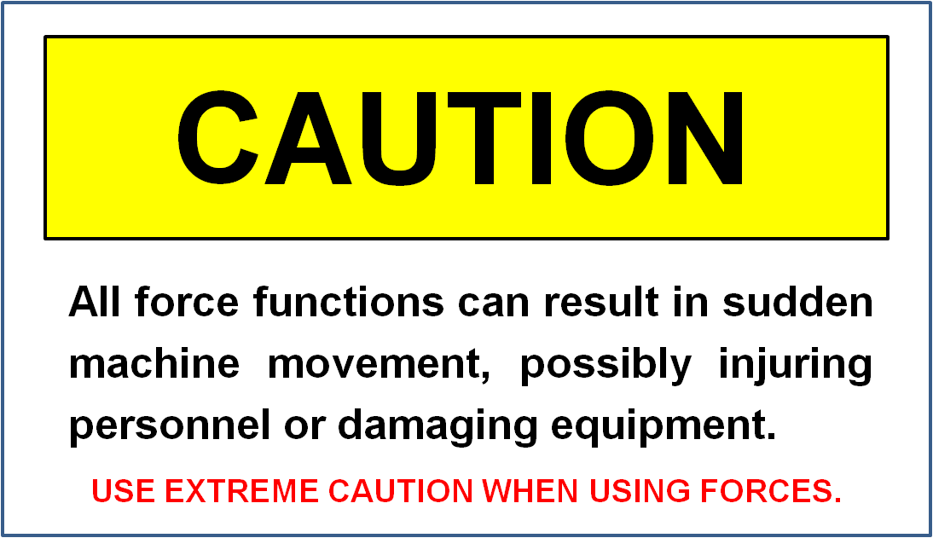
Forcing – Siemens

Slide 3
Forcing – Siemens
Only Inputs and Outputs can be FORCED.
Forces are added in the Force Table.
Forces must be ENABLED.
All or Individual Forces can be Removed.
All or Individual Forces can be Disabled, but remain in program

Slide 4
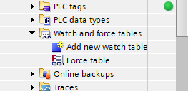
Forcing – Siemens
Forcing Table
In the Project Tree expand Watch and force table and then double left click of Force table.

Slide 5
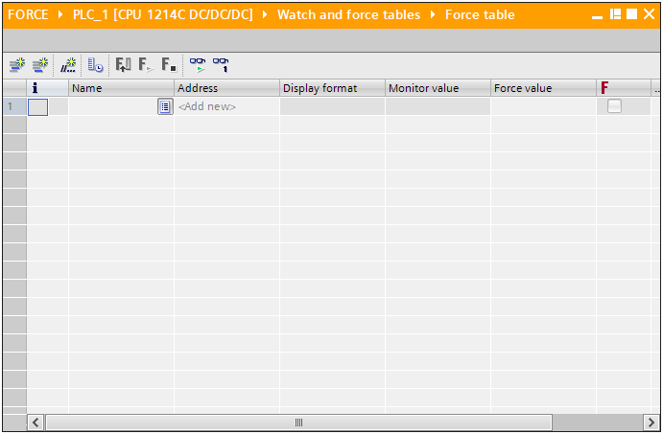
Forcing – Siemens
Forcing Table
The Force table is displayed.

Slide 6
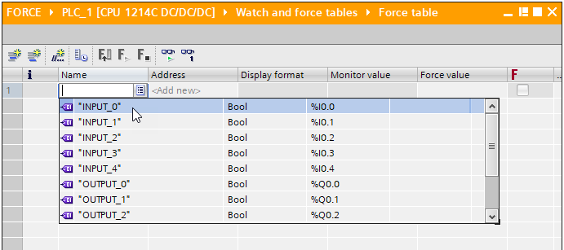
Forcing – Siemens
Add a Force
Left click on the Listing Icon and select the Tag to be forced.

Slide 7
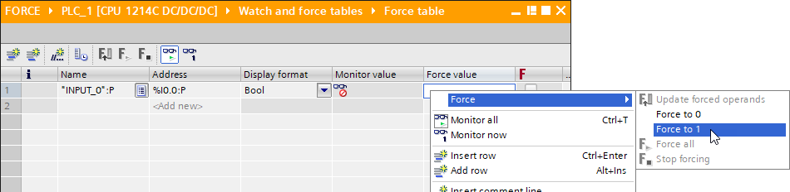
Forcing – Siemens
Add a Force
Right click on the line and select Force and then the Force Type Force to 0 or Force to 1.

Slide 8
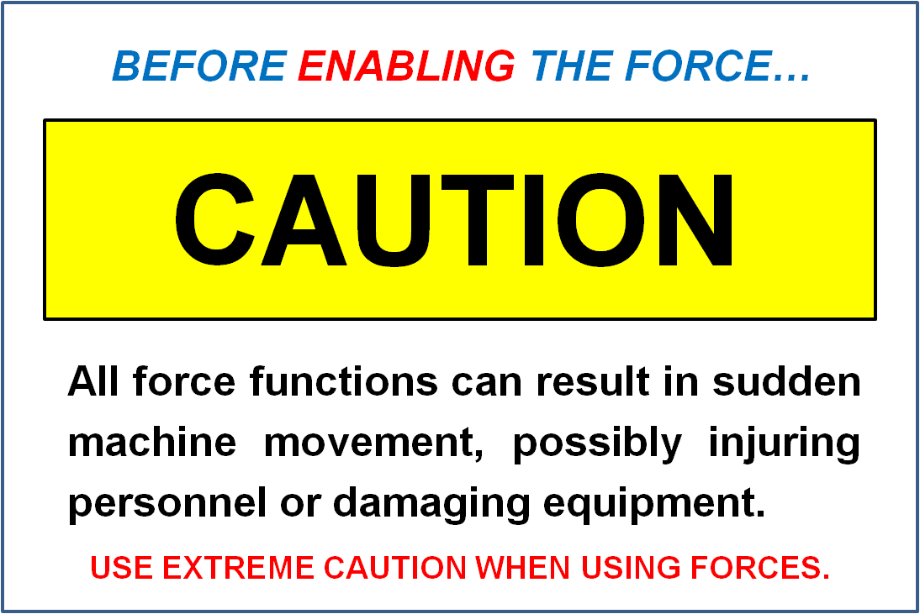
Forcing – Siemens
Enable Forces

Slide 9
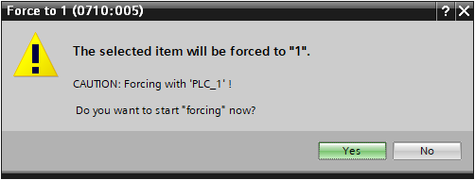
Forcing – Siemens
Add a Force
A prompt warning the Tag will be forced is displayed.

Slide 10
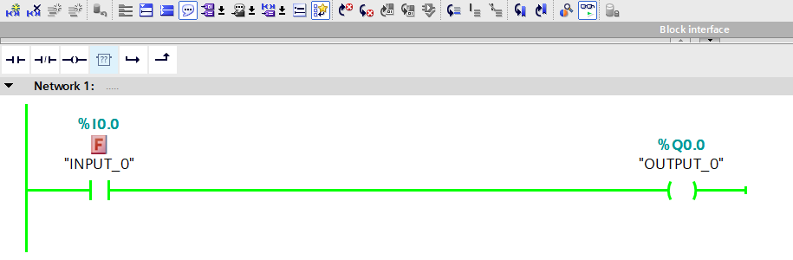
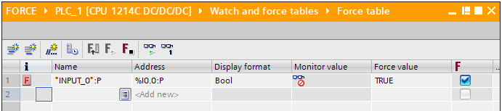
Forcing – Siemens
Add a Force
A Block Red F appears in the Ladder Program and Force Table.

Slide 11
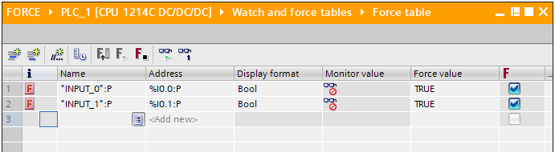
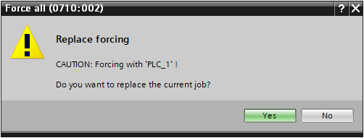
Forcing – Siemens
Add a Force
When additional Tags are added and Forced a prompt to Replace forcing is displayed.

Slide 12
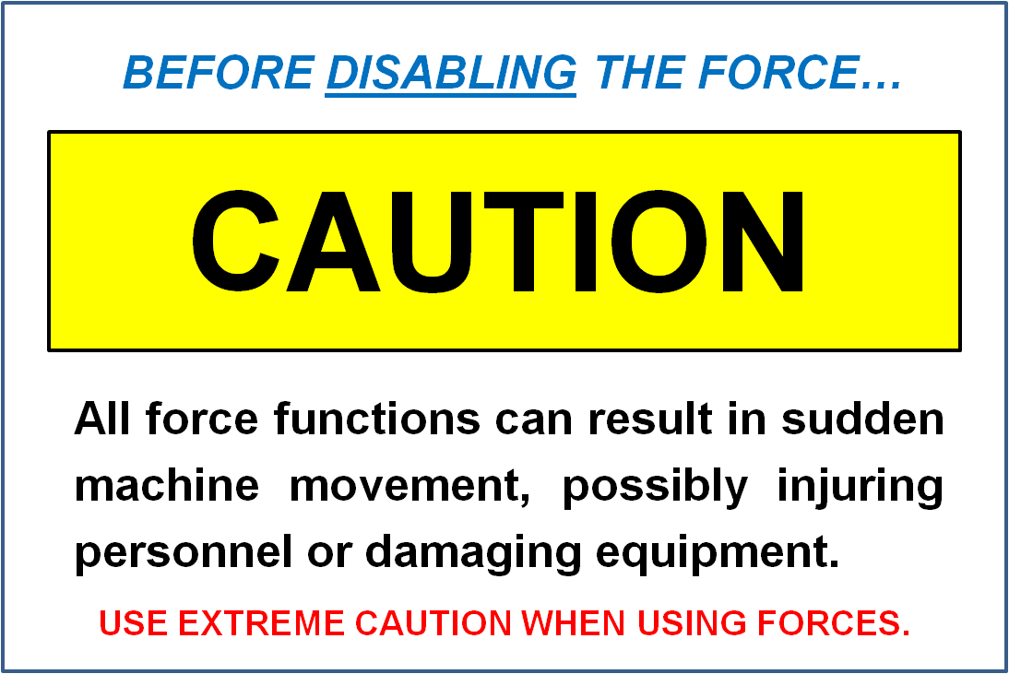
Forcing – Siemens
Disabling All Forces

Slide 13
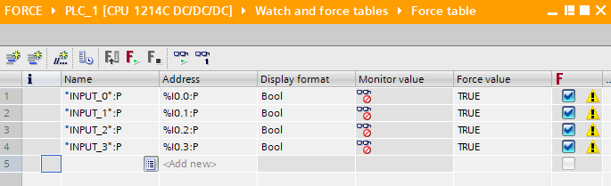
Forcing – Siemens
Stop Forces
To Stop forces, select the Stop forcing icon.
Stopping All Forces is the only option.
Right click on the Force Table will also bring up a context menu to select Forcing and Stop forcing.

Slide 14
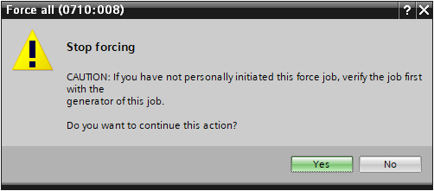
Forcing – Siemens
Stop Forces
A prompt Sop forcing is displayed.

Slide 15
Forcing – Siemens
Stop Forces
All force are Stopped or inactive.
The attention icon indicates force is present but inactive.

Slide 16
Forcing – Siemens
Enable Forces

Slide 17
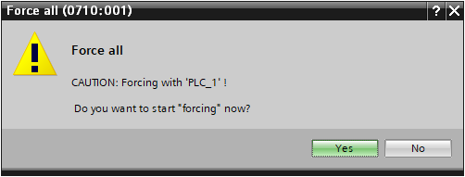
Forcing – Siemens
Start All Force
To Start All Forces select the Start icon.
Right click on the Force Table will also bring up a context menu to select Forcing and Force All.
A prompt Force all is displayed.

Slide 18
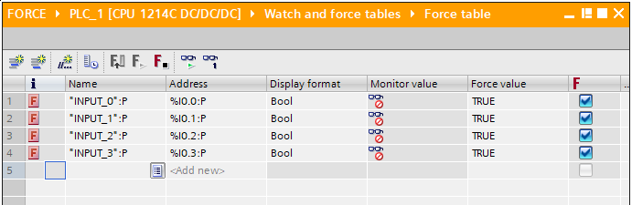
Forcing – Siemens
Start All Force
The Forces will be active.

Slide 19
Forcing – Siemens

Slide 20
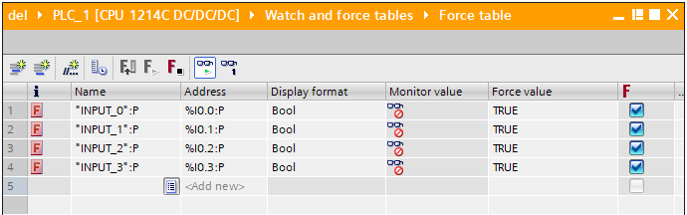
Forcing – Siemens
Start Selected Forces
All Forces are active.

Slide 21
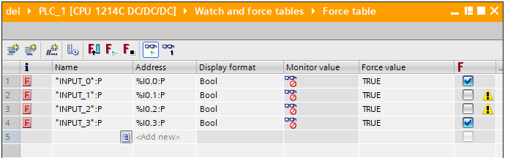
Forcing – Siemens
Start All Force
Uncheck forces to be Forces deactivated.
There is a Warning icon that the Force is de-selected but still active.

Slide 22
Forcing – Siemens
Start Selected Forces
To Start All Forces select the Start icon.
Right click on the Force Table will also bring up a context menu to select Forcing and Force All.
A prompt Force all to Replace is displayed.

Slide 23
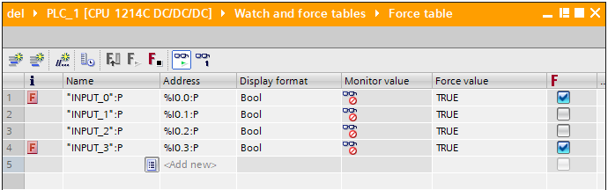
Forcing – Siemens
Start Selected Forces
Only the selected Forces will be active.
The Force Icon is missing to show the Force is not active.

Slide 24
Forcing – Siemens

Slide 25
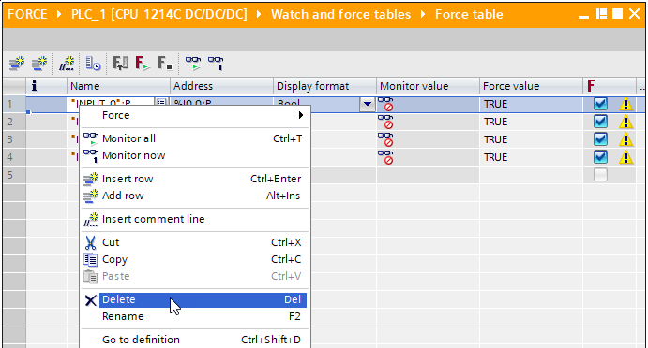
Forcing – Siemens
Delete Forces
To Delete Forces all forces must be Stopped.
Right click on the line of the Force to be deleted and select from the context menu Delete.
Note: holding down the Ctrl key and left clicking on a force line will select multiple forces.

Slide 26
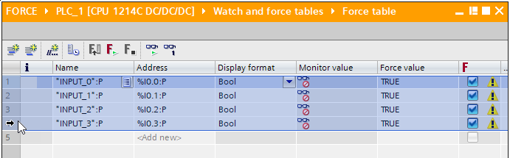
Forcing – Siemens
Delete All Forces
To Delete Forces all forces must be Stopped.
Place the cursor on the line number column and left click and hold while selecting the line numbers.

Slide 27
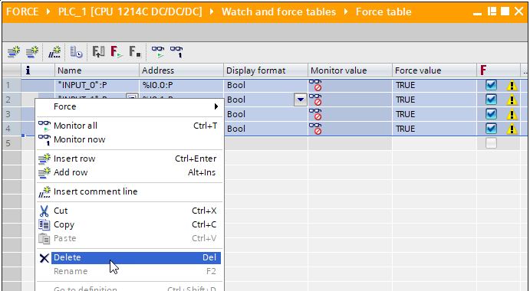
Forcing – Siemens
Delete All Forces
Right click on the line of the Force to be deleted and select from the context menu Delete.

